Slide 1
Making this resource work for you
Prior to teaching this lesson, please refer to the ‘Unit Overview and Planning Document’.
Further guidance on planning Science Mastery lessons can be found in the detailed planning guidance document.
Refer to the ‘notes’ section on each slide for useful information, including suggested expositions, pedagogical content knowledge, suggested questions, answers and more. Consider using presenter mode so you can see this guidance throughout the lesson.
The introduction slides can be adapted to suit your teaching style and the needs of your class.
Before the lesson, adapt the fix-it slide to address any misconceptions identified in the previous lesson’s exit ticket.
Choose from the suggested activities to suit your class. The intention is not that you complete all of these, but that you select those which ones are most appropriate for your students. It may be appropriate to further adapt activities for your students.
These lessons are designed to occupy approximately 1 hour. To adapt for a shorter or longer lesson duration we advise you to adapt the activity section accordingly.
Please consider using the final slide to send feedback about this lesson or examples of PowerPoints that you have adapted to our design team. Your feedback is used to improve Science Mastery for all of our teachers and students. We appreciate all suggestions and comments.
Thank you for reading!
The Science Mastery Team

Slide 2
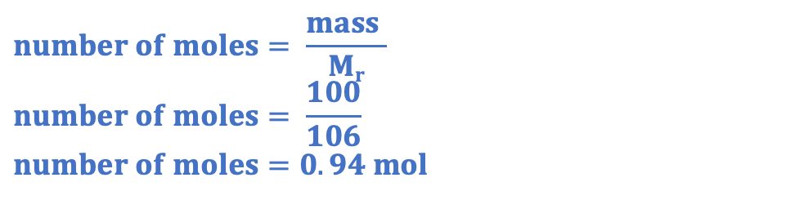
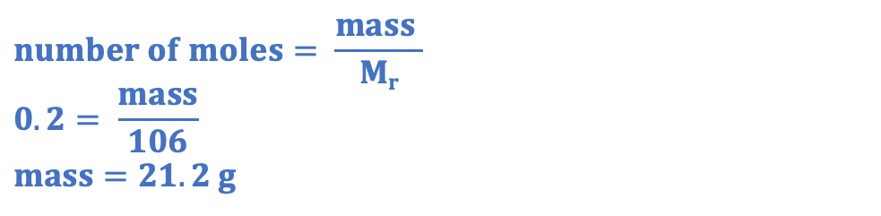
(HT) Limiting Reactants
Answer the questions below.
State which side of a chemical equation the reactants are found on.
Explain why chemical equations must be balanced.
Calculate the relative formula mass of sodium carbonate (Na₂CO₃).
Calculate the mass of 0.2 moles of sodium carbonate.
Calculate the number of moles in 100 g of sodium carbonate.
The left
Because atoms cannot be created or destroyed in a chemical reaction.
(23x2)+12+(16x3) = 106
$$number of moles= \frac{mass }{Mr}$$
$$0.2= \frac{mass}{106}$$
$$mass=21.2 g$$
$$number of moles= \frac{mass }{Mr}$$
$$number of moles= \frac{100}{106}$$
$$number of moles=0.94 mol$$
Notes:
Big idea: Reactions rearrange matter
Foundation: Explain the difference between Ar and Mr.
Stretch: Explain why some elements do not have a whole number for their relative atomic mass.
Answers:
Foundation: Relative atomic mass is the average mass of the atoms of an element compared to carbon 12 whereas relative formula mass is the sum of all the relative atomic masses in a compound or formula.
Stretch: They have isotopes, so their relative atomic mass is the average of the masses of the isotopes, taking into account their relative abundance.

Slide 3
(HT) Limiting Reactants
Do Now:
State which side of a chemical equation the reactants are found on.
Explain why chemical equations must be balanced.
Calculate the relative formula mass of sodium carbonate (Na₂CO₃).
Calculate the mass of 0.2 moles of sodium carbonate.
Calculate the number of moles in 100 g of sodium carbonate.
Drill:
Calculate the M_{r} of lithium nitrate (LiNO₃). L=7, 7=14, O=16
Calculate the M_{r} of copper carbonate (CuCO₃). Cu=63.5, C=12, O=16
Calculate the M_{r} of calcium phosphate (Ca₃(PO₄)₂). Ca=40, P=31, O=16
Notes:
Drill answers:
69
123.5
310

Slide 4
(HT) Limiting Reactants
Read Now:
We can use mole ratios to determine the numbers of particles involved in chemical reactions. We can use a given mass of a reactant to determine the number of moles that were reacting and therefore the number of moles of product that would be made. In reactions where there are two or more reactants, the reactant that has the fewest number of moles is the limiting reactant. This means that it will limit the amount of product that can be made. For example a car factory has made 10 car frames and 100 wheels. This would be enough wheels to make 25 cars, because each car needs 4 wheels, but there are only enough frames to make 10 cars. In this case, the car frame is the limiting reactant, because it determine the maximum amount of product (cars) that can be made.
Explain what is meant by a limiting reactant.
Identify the limiting reactant in the car factory example.
Explain why this is the limiting reactant.
Suggest which would be the limiting reactant if the car factory had made 30 car frames instead.

Slide 5
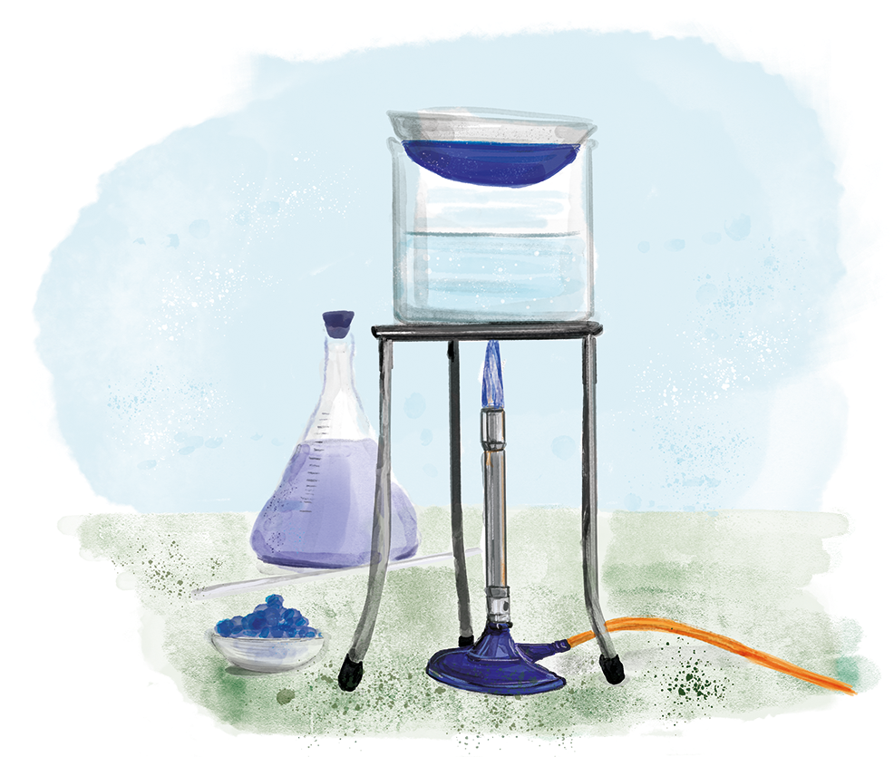
C4.3.8
15/11/2023
(HT) Limiting Reactants
C4.3.1 Prior Knowledge Review
C4.3.2 (HT) Introducing the Mole
C4.3.3 (HT) Mole Calculations
C4.3.4 PKR: Concentration
C4.3.5 TIF: Calculating Concentration
C4.3.6 TIF: Calculating an Unknown Concentration
C4.3.7 (HT) Amounts of Substances in Equations
C4.3.8 (HT) Limiting Reactants
C4.3.9 PKR: Reactions of Acids
C4.3.10 Acids, Alkalis and Neutralisation
C4.3.11 TIF: Acid-Alkali Titration
C4.3.12 TIF: Acid-Alkali Titration Analysis
C4.3.13 TIF: Titration Calculations
C4.3.14 (HT) Strong and Weak Acids
C4.3.15 TIF: Volumes of Gases
Notes:
Big idea: Reactions rearrange matter
In this lesson students will use their knowledge of reacting masses to calculate number of moles and identify limiting reactants. They will practice using these to calculate the mass of products that could be formed. They will revisit this content in C4.4 where they cover percentage yield.
Suggested Hook:
If a car factory makes 10 car frames and 100 wheels, what is the maximum number of complete cars they can make?

Slide 6

Following this lesson, students will be able to:
Calculate number of moles in reactions
Use calculations to identify limiting reactants
Calculate masses of products
Key Words:
mass
moles
M_{r}
mole ratio
limiting reactant
Notes:
Guidance:
See unit overview document and planning guidance to see how these objectives are typically assessed at GCSE, including examples of what students should be able to do following this lesson.
Planning for different needs:
The learning objectives given on this slide are suggested based on the most common requirements for exams, however they can be adapted based on the needs of different classes.
For best practice, the unit preparation booklet should be used to determine the appropriate focus of lessons within the unit.
While it is not possible to explicitly split content into levelled grades, we recommend that lesson objectives can be classified as critical, core or stretch.
Critical: the content or skill is essential for all students to be able to progress.
Core: the content or skill is important for students to progress, but other opportunities may be available to revisit it.
Stretch: the content or skill may not be essential for all students but is important for students aiming for the highest grades.
Key skill: this is a crucial skill being developed in this unit as part of the skill mapping
C4.3.8 Lesson Objectives:
Critical: Calculate number of moles in reactions
Core: Use calculations to identify limiting reactants
Core: Calculate masses of products

Slide 7
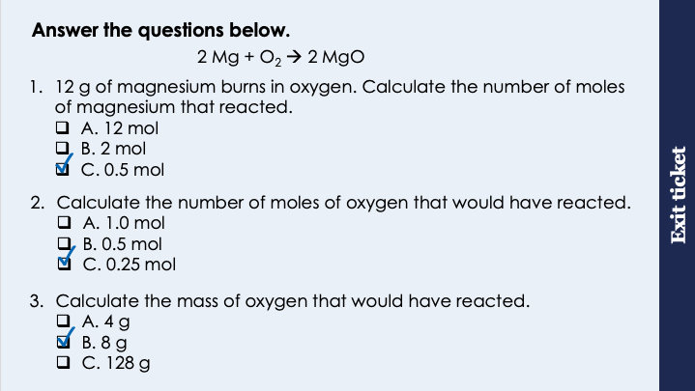
This is the fix-it portion of the lesson
The fix-it is an opportunity to respond to gaps in knowledge, especially those identified by the pre-unit quiz.
The teacher should customise this slide as needed, to facilitate
reteach, explanation, demonstration or modelling of ideas and concepts that students have not yet grasped or have misunderstood.
practise answering specific questions or of key skills.
redrafting or improving previous work.
Notes:
Purpose: to spend time on any gaps identified in previous learning from exit ticket.
Fix-it guidance from previous exit ticket:
Q1. Answer: C
If students answer A, they are not clear on the different between mass and number of moles. If students answer B, they have divided Mr by mass, which is a common error when students assume it is ‘big number over small number’. To fix it, review the equation that links number of moles, mass and Mr and give students lots of practice calculations.
Q2. Answer: C
If students answer A, it shows they have recognised there is a 2:1 mole ratio but have got this the wrong way round. If students answer B, they have not recognised there is a 2:1 mole ratio and have assumed there is the same number of moles of each. To fix it, review mole ratios from balanced chemical equations.
Q3. Answer: B
If students answer A, they have used the Ar of oxygen not the Mr. To fix it, review the meaning of Mr and Ar and get students to practice calculating the Mr of some diatomic elements. If students answer C, they have used the correct Mr of oxygen but have divided Mr by number of moles rather than multiplying. To fix it, review the equation that links number of moles, mass and Mr.

Slide 8


Limiting Reactants
+
→
Limiting reactant
In excess
Notes:
Suggested exposition:
When we have a chemical reaction, the maximum amount of product that can be made depends on how much of each reactant is present. We can think about this with an analogy of a car factory.
Imagine a car factory has made two car bodies/frames. The factory has also made 12 wheels. A complete car can be made from one body and 4 wheels.
How many complete cars could be made from two frames and 12 wheels?
Two.
There are only enough bodies to make two whole cars.
We can say that the car bodies are the limiting reactant as they limit how much product (complete cars) that can be made. We can say that the other reactant, in this case the wheels, is in excess. It is not the limiting reactant.
We can use this same idea to identify the limiting reactant in chemical equations and therefore calculate the maximum mass of product that can be made.

Slide 9
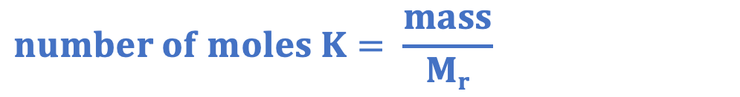
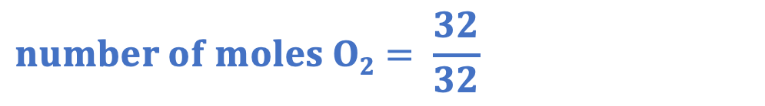
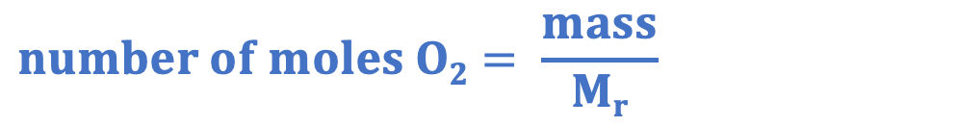
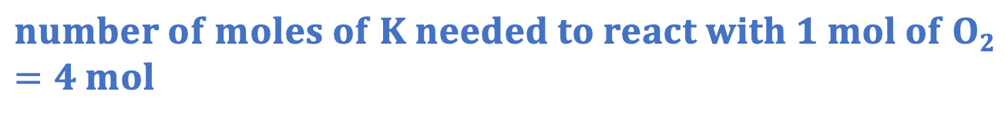
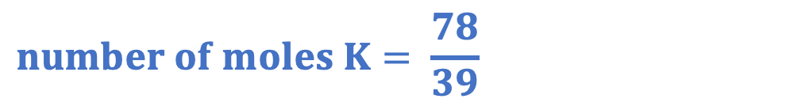
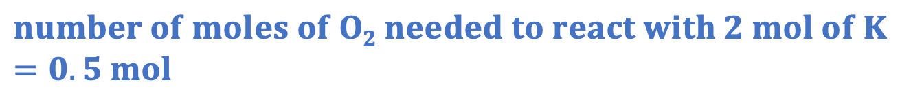
Limiting Reactants
4 K + O₂ → 2 K₂O
Calculate the mass of potassium oxide that can be made from 78 g of potassium and 32 g of oxygen.
mole ratio = 4 : 1
$$number of moles K= \frac{mass}{Mr}$$
$$number of moles O2= \frac{mass}{Mr}$$
$$number of moles K= \frac{78}{39}$$
$$number of moles O2= \frac{32}{32}$$
$$number of moles K=2 mol$$
$$number of moles O2=1 mol$$
$$number of moles of O2 needed to react with 2 mol of K=0.5 mol$$
✅
$$number of moles of K needed to react with 1 mol of O2=4 mol$$
❌
Notes:
Suggested exposition:
We know from the last lesson that we can calculate the mass of a product from the mass of a given reactant using the mole ratios. But if we are given the mass of two reactants, we first have to work out which one is the limiting reactant and therefore will limit the mass of product that can be made. The limiting reactant is the reactant that will run out first, so will be all used up. We can say the other reactant is in excess because it has not run out.
Let’s do an example.
Calculate the mass of potassium oxide that can be made from 78 g of potassium and 32 g of oxygen. This means we have two masses given, so we can calculate the number of moles of each reactant that is present.
We can use the mass in grams and the Mr to calculate the number of moles of potassium that would be present.
This gives us 2 mol of potassium.
We can use the mass in grams and the Mr to calculate the number of moles of oxygen that would be present.
This gives us 1 mol of oxygen.
So which is the limiting reactant?
The easiest way to determine this is to work it out is to see if the reaction is possible or not possible.
Let’s look at potassium first. We have two moles of potassium.
Using the mole ratio, how many moles of oxygen would react with two moles of potassium?
4: 1 ratio, so 0.5 moles of oxygen would react.
Do we have enough oxygen present for this?
Yes. This is possible.
If were to use all the moles of oxygen, how many moles of potassium would we need?
4:1 ratio, so 4 moles of potassium would be needed.
Do we have enough potassium present for this?
No. This is not possible. There is not enough potassium present to react with all the oxygen, so potassium is our limiting reactant.
We can then use the same method as last lesson to calculate the mass of potassium oxide that could be formed from this limiting reactant.

Slide 10
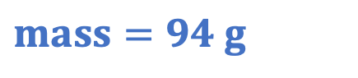
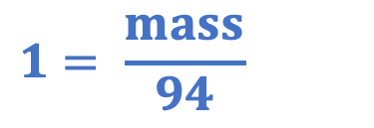
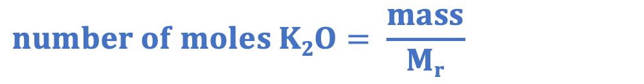
Limiting Reactants
4 K + O₂ → 2 K₂O
Calculate the mass of potassium oxide that can be made from 78 g of potassium and 32 g of oxygen.
mole ratio = 4 : 2
$$number of moles K= \frac{mass}{Mr}$$
$$number of moles K2O=1 mol$$
$$number of moles K2O= \frac{mass}{Mr}$$
$$number of moles K= \frac{78}{39}$$
$$1= \frac{mass}{94}$$
$$number of moles K=2 mol$$
$$mass=94 g$$
Notes:
Suggested exposition:
Once we have identified the limiting reactant, then we can use the same method as last lesson to calculate the mass of product that could be formed.
We know that 2 moles of potassium is limiting the reaction, so using our mole ratio of 4:2 this time, we know that 1 mole of potassium oxide will be formed. We can use the equation then to calculate the mass of potassium oxide that would be formed using its Mr, giving us a mass of 94 g.

Slide 11

Is this correct?
4 K + O₂ → 2 K₂O
39 g of potassium reacts with 32 g of oxygen.
Oxygen is the limiting reactant because the mole ratio is 4:1.
Notes:
This is not correct, but is a common misconception that the species with the lowest/no coefficient is automatically the limiting reactant. You may wish to show this with a calculation.
Number of moles K = 39/39 = 1 mol
Number of moles O2 = 32/32 = 1 mol
How many moles of O2 would be needed to react with 1 mol of K? 0.25 mol - this is possible
How many moles of K would be needed to react with 1 mol of O2? 4 mol - this is not possible, so potassium is the limiting reactant.
Suggested guidance:
Talk tasks can be used in a variety of ways to suit the particular needs of the students you are teaching. Through exchanging views with others, students develop their understanding of the science beyond what could be achieved individually.
Science classrooms that successfully integrate talk have the following features:
Science talk is a regular feature of lessons and is woven into classroom activities.
Students are paired or grouped strategically by the teacher to ensure productive interaction. This might take into consideration the students’ proficiency of the English language, how encouraging they might be to peers and their attainment in the topic. It’s a good idea to consider these pairings in the class seating plan.
Students are encouraged and supported to talk, but are not forced to talk.
The teacher should take on the role of a facilitator, engaging with conversations where necessary and encouraging or steering the conversation where needed.
Students are encouraged to use the language they have to express their ideas (e.g., everyday language, imperfect English, native language), but also to incorporate science specific terminology where this is more accurate or has been taught.
6. Scientifically inaccurate ideas are not dismissed by the partner or teacher; open discussion and further investigation are relied on to help students construct ideas that support them to progress in their scientific understanding.
7. Guidelines for behaviour during talk tasks are explicit and frequently reviewed. Rules for students might be:
Listen carefully to your partner
Take turns talking.
Speak one at a time, without interrupting.
Politely agree or disagree and explain why.
Politely point out if your partner has used a scientific word incorrectly, if they have explained the science incorrectly, or if there is a more accurate way to describe something.
If confused, ask questions.
Stay focused on the discussion topic.
Respond to one another.

Slide 12
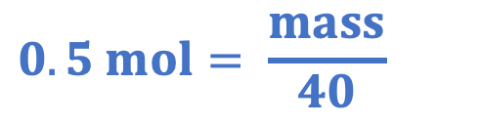
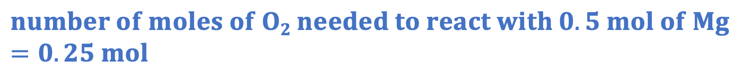
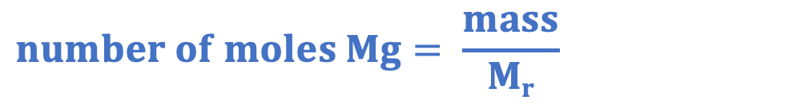
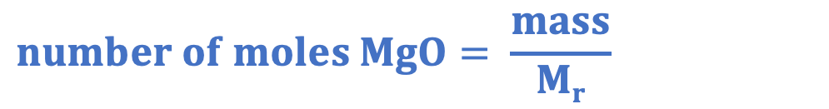
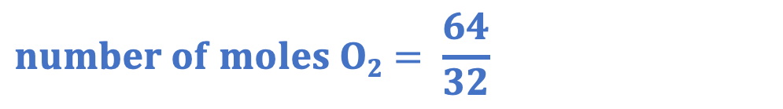
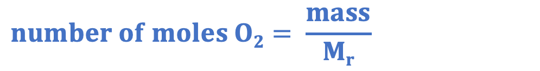
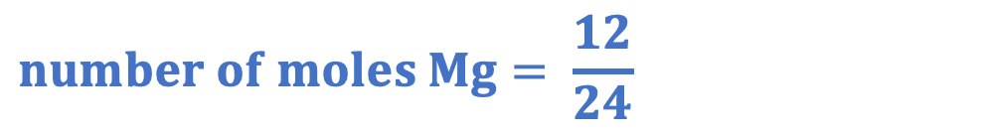
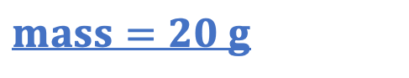
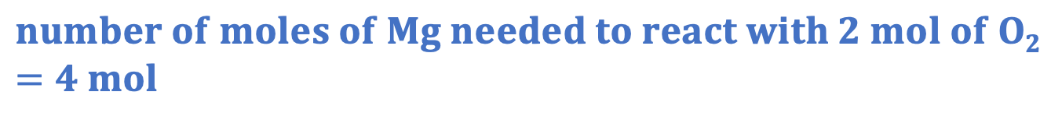
Describe how you would solve this question.
2 Mg + O₂ → 2 MgO
Calculate the mass of magnesium that could be made from 12 g of magnesium and 64 g of oxygen.
mole ratio = 2 : 2
mole ratio = 2 : 1
$$number of moles MgO=0.5 mol$$
$$number of moles Mg= \frac{mass}{Mr}$$
$$number of moles O2= \frac{mass}{Mr}$$
$$number of moles MgO= \frac{mass}{Mr}$$
$$number of moles Mg= \frac{12}{24}$$
$$number of moles O2= \frac{64}{32}$$
$$0.5 mol= \frac{mass}{40}$$
$$number of moles Mg=0.5 mol$$
$$number of moles O2=2 mol$$
$$mass=20 g$$
$$number of moles of O2 needed to react with 0.5 mol of Mg=0.25 mol$$
✅
$$number of moles of Mg needed to react with 2 mol of O2=4 mol$$
❌
Notes:
This can be used to get students to try and describe the steps involved in the calculation. More worked example practice is given in the I/We/You cycle.
Suggested guidance:
Talk tasks can be used in a variety of ways to suit the particular needs of the students you are teaching. Through exchanging views with others, students develop their understanding of the science beyond what could be achieved individually.
Science classrooms that successfully integrate talk have the following features:
Science talk is a regular feature of lessons and is woven into classroom activities.
Students are paired or grouped strategically by the teacher to ensure productive interaction. This might take into consideration the students’ proficiency of the English language, how encouraging they might be to peers and their attainment in the topic. It’s a good idea to consider these pairings in the class seating plan.
Students are encouraged and supported to talk, but are not forced to talk.
The teacher should take on the role of a facilitator, engaging with conversations where necessary and encouraging or steering the conversation where needed.
Students are encouraged to use the language they have to express their ideas (e.g., everyday language, imperfect English, native language), but also to incorporate science specific terminology where this is more accurate or has been taught.
6. Scientifically inaccurate ideas are not dismissed by the partner or teacher; open discussion and further investigation are relied on to help students construct ideas that support them to progress in their scientific understanding.
7. Guidelines for behaviour during talk tasks are explicit and frequently reviewed. Rules for students might be:
Listen carefully to your partner
Take turns talking.
Speak one at a time, without interrupting.
Politely agree or disagree and explain why.
Politely point out if your partner has used a scientific word incorrectly, if they have explained the science incorrectly, or if there is a more accurate way to describe something.
If confused, ask questions.
Stay focused on the discussion topic.
Respond to one another.

Slide 13
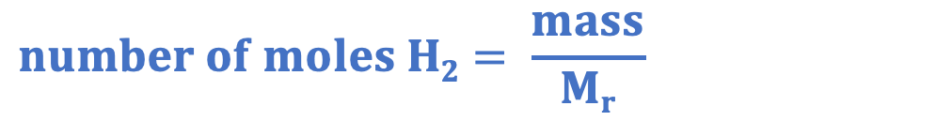
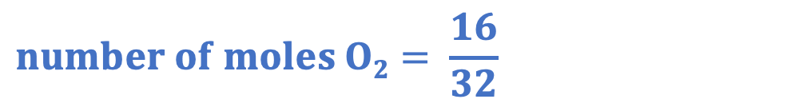

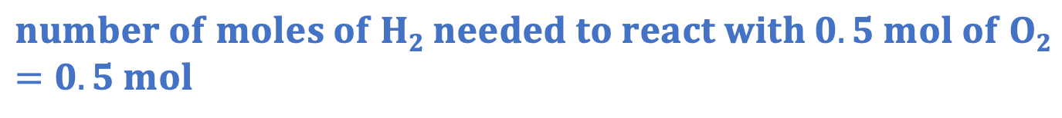
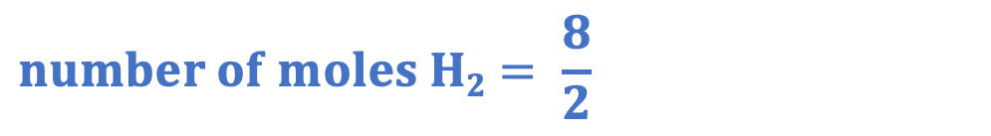
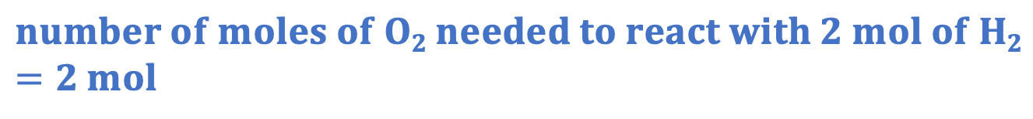
Identify the mistake(s) in this working.
2 H₂ + O₂ → 2 H₂O
Identify the limiting reactant when 8 g of hydrogen reacts with 16 g of oxygen.
mole ratio = 2 : 1
$$number of moles H2= \frac{mass}{Mr}$$
$$number of moles O2= \frac{mass}{Mr}$$
$$number of moles H2= \frac{8}{2}$$
$$number of moles O2= \frac{16}{32}$$
$$number of moles H2=2 mol$$
$$number of moles O2=0.5 mol$$
$$number of moles of O2 needed to react with 2 mol of H2=2 mol$$
❌
$$number of moles of H2 needed to react with 0.5 mol of O2=0.5 mol$$
✅
Notes:
This is a common mistake, where students have forgotten to use the mole ratio. They have identified the correct limiting reactant but the working is incorrect.

Slide 14
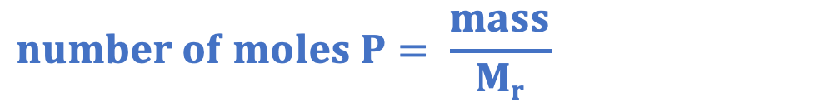
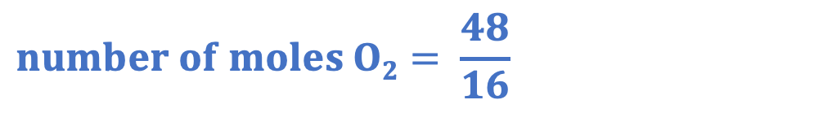
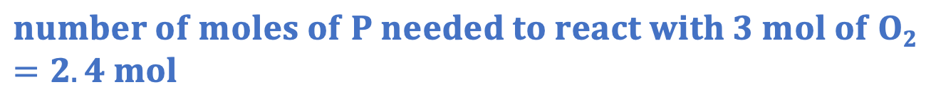
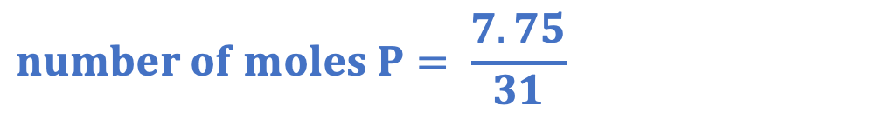
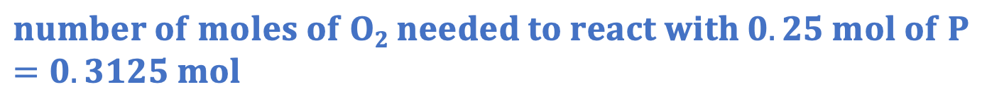
Identify the mistake(s) in this working.
4 P + 5 O₂ → 2 P₂O₅
Identify the limiting reactant when 7.75 g of phosporus reacts with 48 g of oxygen.
mole ratio = 4 : 5
$$number of moles P= \frac{mass}{Mr}$$
$$number of moles O2= \frac{mass}{Mr}$$
$$number of moles P= \frac{7.75}{31}$$
$$number of moles O2= \frac{48}{16}$$
$$number of moles P=0.25 mol$$
$$number of moles O2=3 mol$$
$$number of moles of O2 needed to react with 0.25 mol of P=0.3125 mol$$
✅
$$number of moles of P needed to react with 3 mol of O2=2.4 mol$$
❌

Slide 15
Drill
State the equation that links number of moles, mass and M_{r}.
Explain what is meant by a limiting reactant.
Explain what it means for a reactant to be in excess.
Describe where reactants and products are found in a chemical equation.
State the units for number of moles.
Notes:
Purpose: This is a knowledge drill. The purpose of this is to check that the critical knowledge is secure before pupils move onto independent practice.
Suggested guidance: There are a range of ways this could be done depending on time and ability range of the class:
Mini whiteboards
As full sentences in exercise books
As short answers in exercise books
In the pupil workbook
As pair talk
As cold call

Slide 16
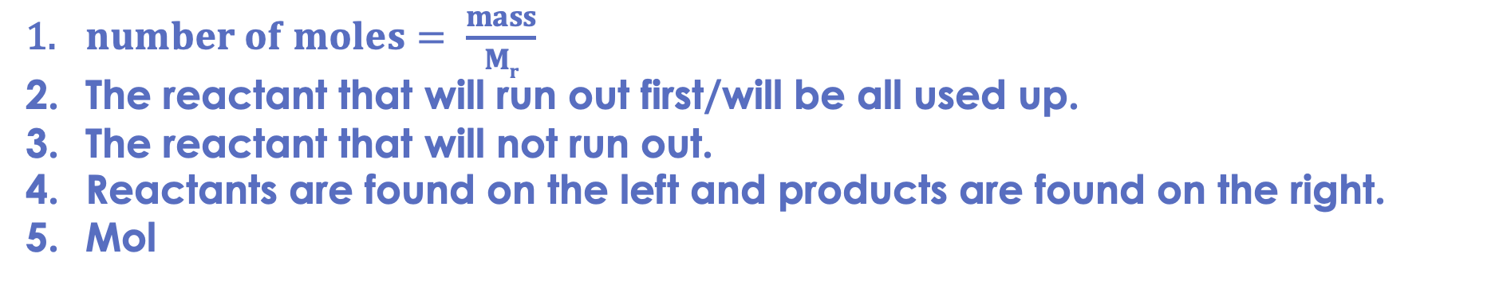
Drill answers
$number of moles= \frac{mass}{Mr}$
The reactant that will run out first/will be all used up.
The reactant that will not run out.
Reactants are found on the left and products are found on the right.
Mol
Notes:
Purpose: This is a knowledge drill. The purpose of this is to check that the critical knowledge is secure before pupils move onto independent practice.
Suggested guidance: There are a range of ways this could be done depending on time and ability range of the class:
Mini whiteboards
As full sentences in exercise books
As short answers in exercise books
In the pupil workbook
As pair talk
As cold call

Slide 17
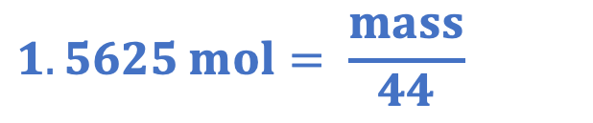

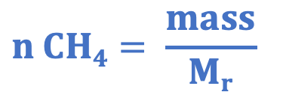
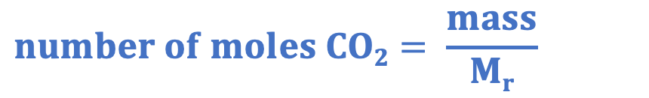
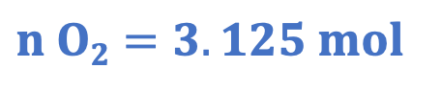
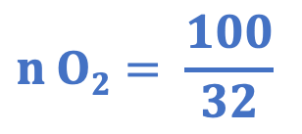
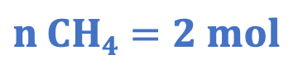
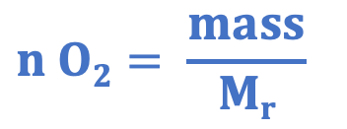
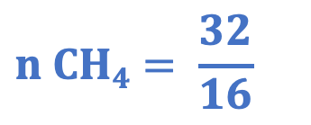
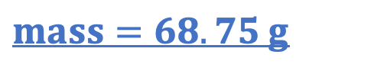
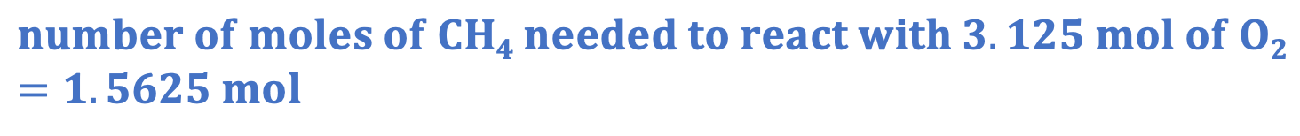
I: using limiting reactants in calculations
CH₄ + 2 O₂ → 2 H₂O + CO₂
Calculate the mass of carbon dioxide that would be formed when 32 g of methane burns in 100 g of oxygen.
mole ratio = 2 : 1
mole ratio = 1 : 2
$$n O2= \frac{mass}{Mr}$$
$$number of moles CO2=1.5625 mol$$
$$n CH4= \frac{mass}{Mr}$$
$$number of moles CO2= \frac{mass}{Mr}$$
$$n CH4= \frac{32}{16}$$
$$n O2= \frac{100}{32}$$
$$1.5625 mol= \frac{mass}{44}$$
$$n CH4=2 mol$$
$$n O2=3.125 mol$$
$$mass=68.75 g$$
$$number of moles of O2 needed to react with 2 mol of CH4=4 mol$$
❌
$$number of moles of CH4 needed to react with 3.125 mol of O2=1.5625 mol$$
✅
Notes:
The examples chosen for the I/We/You section provide practice working with different numbers in the mole ratios.
Purpose: The I-We-You section aims to support pupils to build skills that they most commonly need when answering questions associated with this knowledge in the assessment. This section is also used to interleave other content we expect pupils to know at this stage of their education in order that they build a big picture of the science they are learning.
For the ‘I’ activity, the teacher should model how to answer the question. They can do this by narrating their thinking process aloud, and making links to learning earlier in the lesson explicit.
For the ‘we’ activity, the teacher and students work though a similar example together, in order to prepare students to be able to answer a similar question independently.
Opportunities for the ‘you’ activity – independent practise – occur in the activity portion of the lesson once the student is secure enough to process independently.

Slide 18
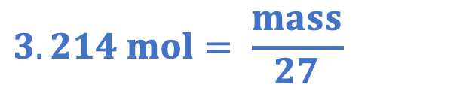
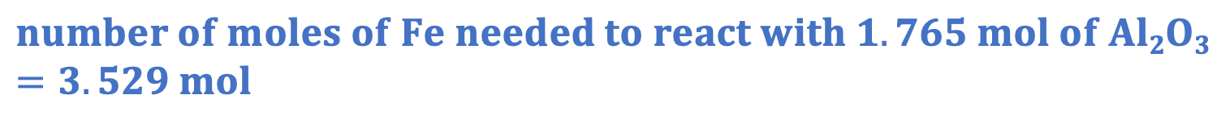
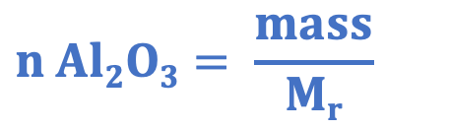
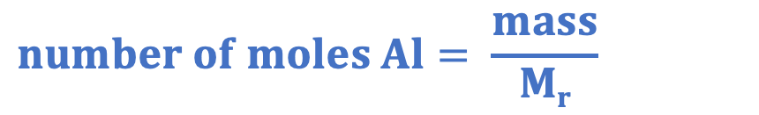

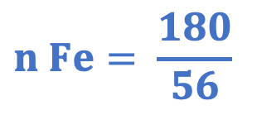
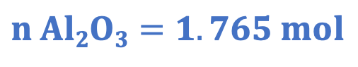
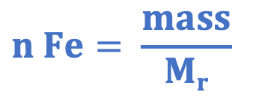



We: using limiting reactants in calculations
Al₂O₃ + 2 Fe → Fe₂O₃ + 2 Al
Calculate the mass of aluminium that could be made from 180 g of aluminium oxide and 180 g of iron.
mole ratio = 2 : 2
mole ratio = 1 : 2
$$n Fe= \frac{mass}{Mr}$$
$$number of moles Al=3.214 mol$$
$$n Al2O3= \frac{mass}{Mr}$$
$$number of moles Al= \frac{mass}{Mr}$$
$$n Al2O3= \frac{180}{102}$$
$$n Fe= \frac{180}{56}$$
$$3.214 mol= \frac{mass}{27}$$
$$n Al2O3=1.765 mol$$
$$n Fe=3.214 mol$$
$$mass=86.79 g$$
$$number of moles of Fe needed to react with 1.765 mol of Al2O3=3.529 mol$$
❌
$$number of moles of Al2O3needed to react with 3.214 mol of Fe=1.607 mol$$
✅
Notes:
Purpose: The I-We-You section aims to support pupils to build skills that they most commonly need when answering questions associated with this knowledge in the assessment. This section is also used to interleave other content we expect pupils to know at this stage of their education in order that they build a big picture of the science they are learning.
For the ‘I’ activity, the teacher should model how to answer the question. They can do this by narrating their thinking process aloud, and making links to learning earlier in the lesson explicit.
For the ‘we’ activity, the teacher and students work though a similar example together, in order to prepare students to be able to answer a similar question independently.
Opportunities for the ‘you’ activity – independent practise – occur in the activity portion of the lesson once the student is secure enough to process independently.

Slide 19











You: using limiting reactants in calculations
N₂ + 3 H₂ → 2 NH₃
Calculate the mass of ammonia that could be made from 50 g of nitrogen and 50 g of hydrogen.
mole ratio = 1 : 2
mole ratio = 1 : 3
$$n H2= \frac{mass}{Mr}$$
$$number of moles NH3=3.571 mol$$
$$n N2= \frac{mass}{Mr}$$
$$number of moles NH3= \frac{mass}{Mr}$$
$$n N2= \frac{50}{28}$$
$$n H2= \frac{50}{4}$$
$$3.571 mol= \frac{mass}{17}$$
$$n N2=1.786 mol$$
$$n H2=12.5 mol$$
$$mass=60.71 g$$
$$number of moles of H2 needed to react with 1.786 mol of N2=5.357 mol$$
✅
$$number of moles of N2 needed to react with 12.5 mol of H2=4.167 mol$$
❌
Notes:
Purpose: The I-We-You section aims to support pupils to build skills that they most commonly need when answering questions associated with this knowledge in the assessment. This section is also used to interleave other content we expect pupils to know at this stage of their education in order that they build a big picture of the science they are learning.
For the ‘I’ activity, the teacher should model how to answer the question. They can do this by narrating their thinking process aloud, and making links to learning earlier in the lesson explicit.
For the ‘we’ activity, the teacher and students work though a similar example together, in order to prepare students to be able to answer a similar question independently.
Opportunities for the ‘you’ activity – independent practise – occur in the activity portion of the lesson once the student is secure enough to process independently.

Slide 20



Activity

Slide 21
Answers
1. The reactant that will run out first.
2. It is in excess.
3. 2 Ca + O₂ ➔ 2 CaO
4. Atoms cannot be created or destroyed in a chemical reaction, so there need to be the same number of each type of atom on each side.
5a. 44
5b. Oxygen

Slide 22


Answers
6a.
$$Number of moles Al= \frac{mass}{Mr}$$
$$Number of moles Al= \frac{1500}{27}$$
$$Number of moles=55.555… mol$$
$$Number of moles Fe2O3= \frac{mass}{Mr}$$
$$Number of moles Fe2O3= \frac{2800}{160}$$
$$Number of moles=17.5… mol$$
Mole ratio = 2:1
$number of moles of Fe2O3 needed to react with 55.55 mol of Al=27.777 mol$ (not possible)
$number of moles of Al needed to react with 17.5 mol of Fe2O3=35 mol$(possible)
Limiting reactant = Fe₂O₃
6b.
Mole ratio = 1:2
$$Number of moles Fe=35 mol$$
$$Number of moles Fe= \frac{mass}{Mr}$$
$$35 mol= \frac{mass}{56}$$
$$Mass=1 960 g$$

Slide 23


Answers
7a.
$$Number of moles Mg= \frac{mass}{Mr}$$
$$Number of moles Mg= \frac{750}{24}$$
$$Number of moles=31.25 mol$$
$$Number of moles CuO= \frac{mass}{Mr}$$
$$Number of moles CuO= \frac{750}{79.5}$$
$$Number of moles=9.433… mol$$
Mole ratio = 1:1
$number of moles of CuO needed to react with 31.25 mol of Mg=31.25 mol$ (not possible)
$number of moles of Mg needed to react with 9.433 mol of CuO=18. 679…mol$(possible)
Limiting reactant = CuO
7b.
Mole ratio = 1:1
$$Number of moles Cu=9.433…mol$$
$$Number of moles Cu= \frac{mass}{Mr}$$
$$9.433… mol= \frac{mass}{63.5}$$
$$Mass=599.06 g$$

Slide 24

Answers
8.
$$Concentration CuSO4= \frac{mass}{volume}$$
$$50= \frac{mass}{0.1}$$
$$Mass=5 g$$
$$Number of moles CuSO4= \frac{mass}{Mr}$$
$$Number of moles CuSO4= \frac{5}{159.5}$$
$$Number of moles CuSO4=0.0313…mol$$
Mole ratio = 1:1
$$Number of moles Fe=0.0313$$
$$Number of moles Fe= \frac{mass}{Mr}$$
$$0.0313= \frac{mass}{56}$$
$$Mass=1.76 g$$

Slide 25



Answers
9d.
Mole ratio = 1:6
$$Number of moles H2O=1.33{ ×10}^{−6} mol$$
$$Number of moles H2O= \frac{mass}{Mr}$$
$$1.33{ ×10}^{−6}= \frac{mass}{18}$$
$$Mass=2.4{ ×10}^{−4 }g$$
9a. (12x6)+(1x12)+(16x6) = 180
9b.
$$Number of moles C6H12O6= \frac{mass}{Mr}$$
$$Number of moles C6H12O6= \frac{4 {×10}^{−5}}{180}$$
$$Number of moles C6H12O6=2.22{ ×10}^{−7}mol$$
$$Number of moles O2= \frac{mass}{Mr}$$
$$Number of moles O2= \frac{7.5 {×10}^{−5}}{32}$$
$$Number of moles O2=2.34{ ×10}^{−6}mol$$
9c.
Mole ratio = 1:6
$n of O2 needed to react with 2.22{ ×10}^{−7}mol of C6H12O6=1.33{ ×10}^{−6} mol$ (possible)
$n of C6H12O6 needed to react with 2.34{ ×10}^{−6}mol of O2=3.906{ ×10}^{−7}mol$(not possible)
Limiting reactant = C₆H₁₂O₆

Slide 26
Answers
9e. Muscle tissue starts to respire anaerobically instead.
9f. Suggested points:
Both have glucose as a reactant
Both release energy
Aerobic respiration also has oxygen as a reactant
Anaerobic respiration produces lactic acid in animal cells and ethanol and carbon dioxide in plant cells and yeast
Aerobic respiration releases much more (19x more) energy than anaerobic respiration

Slide 27
Answer the questions below.
2 Mg + O₂ → 2 MgO
48 g of magnesium burns in 100 g of oxygen.
Calculate the number of moles of magnesium present.
A. 0.5 mol
B. 1 mol
C. 2 mol
✓
Calculate the number of moles of oxygen present.
A. 6.25 mol
B. 3.125 mol
C. 0.32 mol
✓
Which is the limiting reactant?
A. Mg
B. O₂
C. MgO
✓
Notes:
For this exit ticket, it is worth showing going through the answer to each question before starting the next question to reduce errors carried forward.
Q1. Answer: C
If students answer A, they are have divided Mr by mass. If students answer B, they have used the coefficient to calculate the Mr. To fix it, review the equation that links number of moles, mass and Mr and give students lots of practice calculations.
Q2. Answer: B
If students answer A, it shows they have used the Ar not the Mr. If students answer C, they have divided Mr by mass. To fix it, review number of moles, mass and Mr calculations.
Q3. Answer: A
If students answer B, they have not used the mole ratio to determine the limiting reactant. If students answer C, they have not recognised that the limiting reactant needs to be a reactant. To fix it, review the meaning of a limiting reactant and model another example question for students, followed by lots of practice.

Slide 28
Lesson C4.3.8
What was good about this lesson? | What can we do to improve this lesson?
Send us your feedback by clicking this link
or by emailing sciencemastery@arkonline.org
Thank you!

